Slide 1
Technical writing style
Polishing style

Slide 2
Tips for improving technical writing style

Slide 3
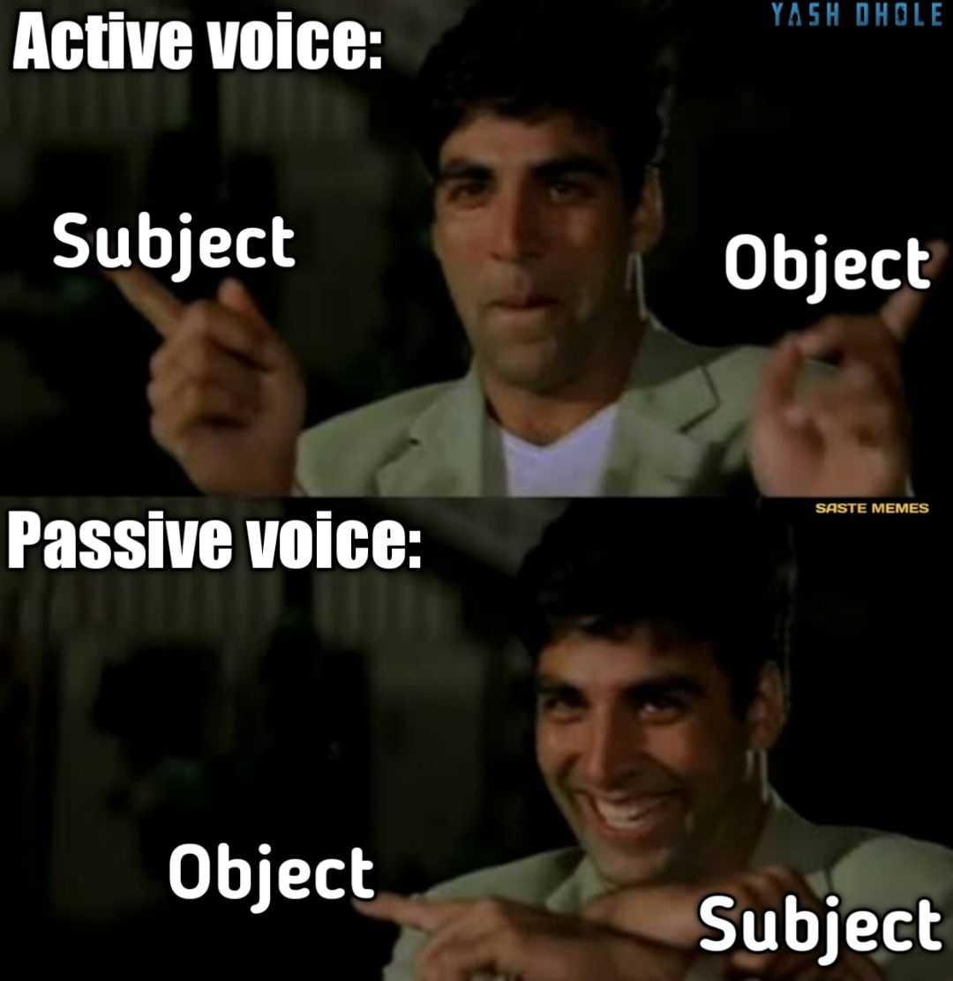

1. Write in the Active Voice

Slide 4
Why active > passive voice
Normal word order is SVO
less wordy and confusing.
items in top-down order
The planning committee discovered that the room wasn’t available. (active)
It was discovered by the planning committee that the room wasn’t available. (passive)

Slide 5
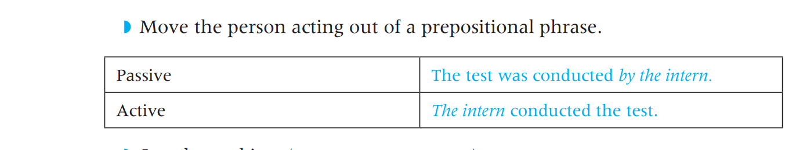
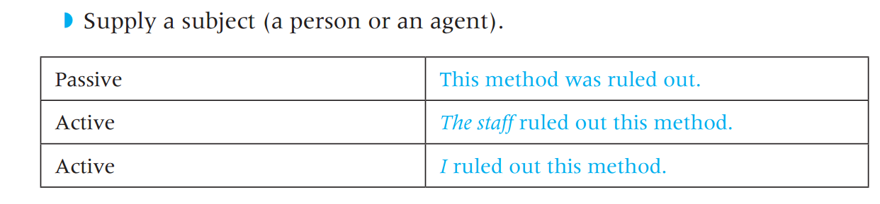
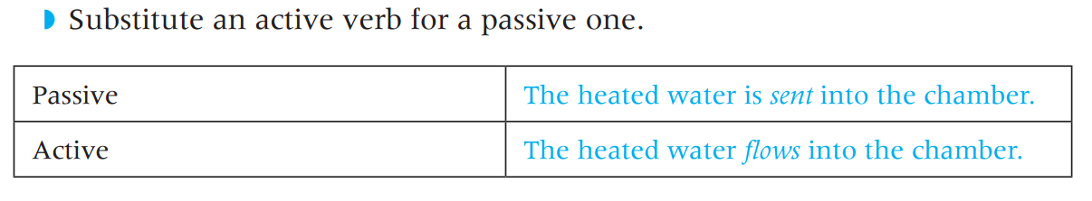
Change Passive to Active

Slide 6
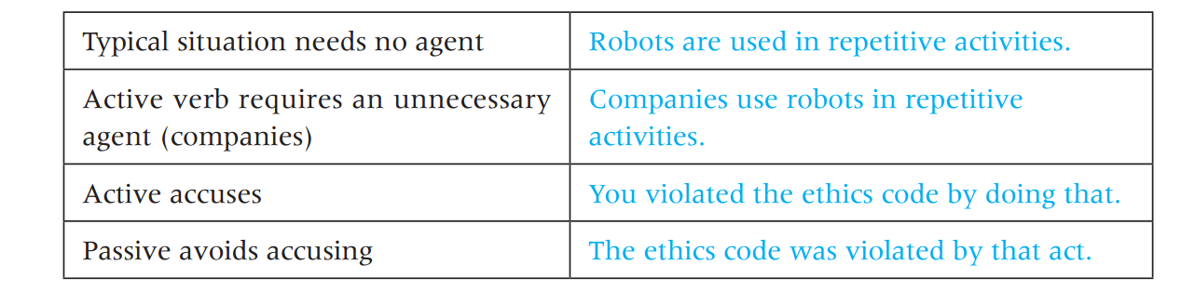
Use the Passive If It Is Accurate

Slide 7
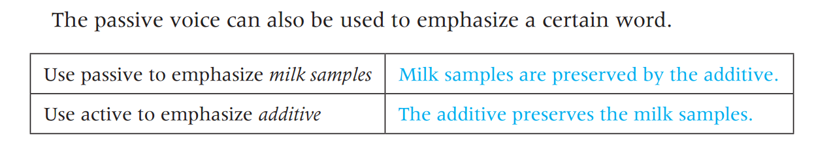

Slide 8
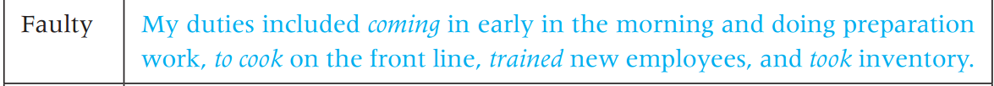
2. Use Parallelism

Slide 9
3. Use There Are (indefinite phrase) Sparingly
Ineffective.
There is a change in efficiency policy that could increase our profits.
Effective
Our profits will increase if we change our efficiency policy.
Notes:
weakens meaning by “burying” the subject in the middle of
the sentence

Slide 10
Ineffective
There are three problems that this process has.
Effective
This process has three problems.
Ineffective
There are two reasons why we should talk about abandoning our current location.
Effective
We should abandon our current location for two reasons

Slide 11
Exercise: Eliminate there are, or any related form, from the following sentences.
There are several methods of research that I will use.
• There are slowness and inefficiency in the data processing and information retrieval.
• There is a need for some XML code to be learned by me.
• There is a reliance on business to provide product information on the Web.

Slide 12
4. Avoid Nominalizations
Notes:
verbs turned into nouns by adding a
suffix such as -ion, -ity, -ment, or -ness

Slide 13
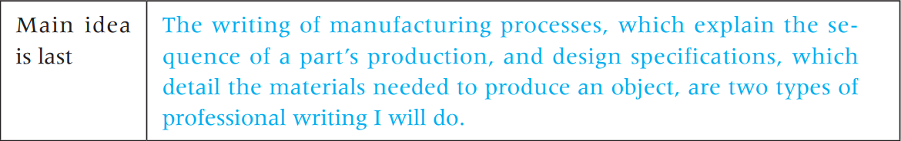
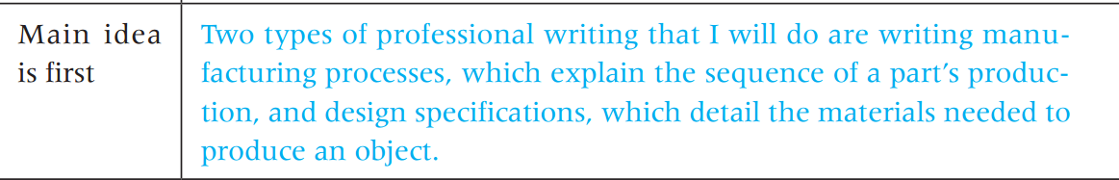
5. Put the Main Idea First

Slide 14
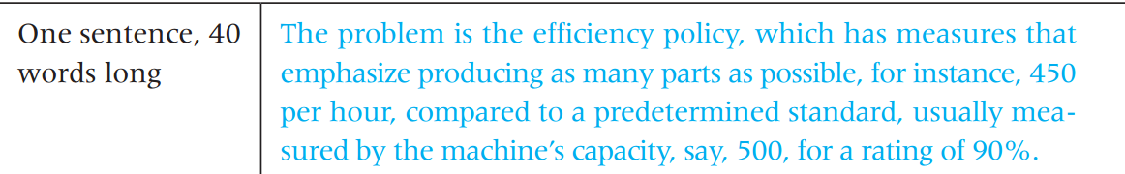
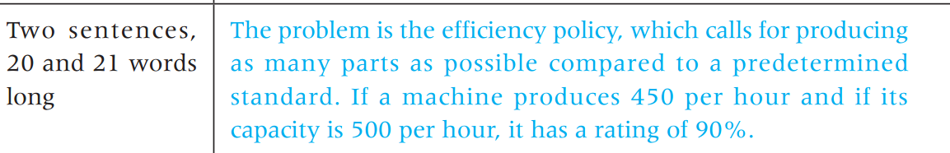
6. Write Sentences of 12 to 25 Words
Notes:
long. Shorter and longer sentences are
harder to read because they become too simple or too complicated.

Slide 15
7. Use You Correctly
Do not use you in formal reports
you means “the reader”; it should not mean “I,” or a very informal substitute for “the” or “a
“This is your basic hammer.”

Slide 17
8. Avoid Sexist Language

Slide 18
Eliminate Common Clarity Errors

Slide 19
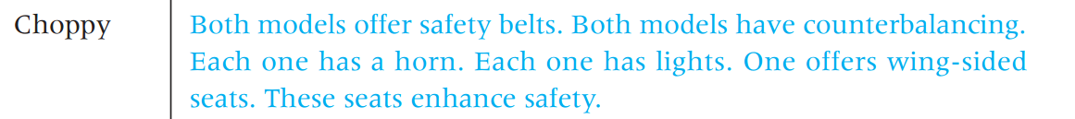
1. Avoid Strings of Choppy Sentences

Slide 20
2. Avoid Wordiness and Redundancy

Slide 21
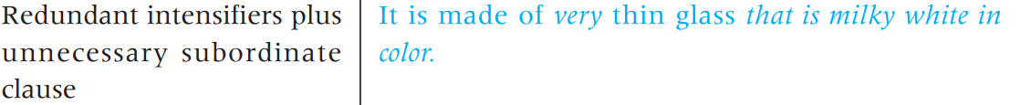

Slide 23
3. Avoid Noun Clusters

Slide 24
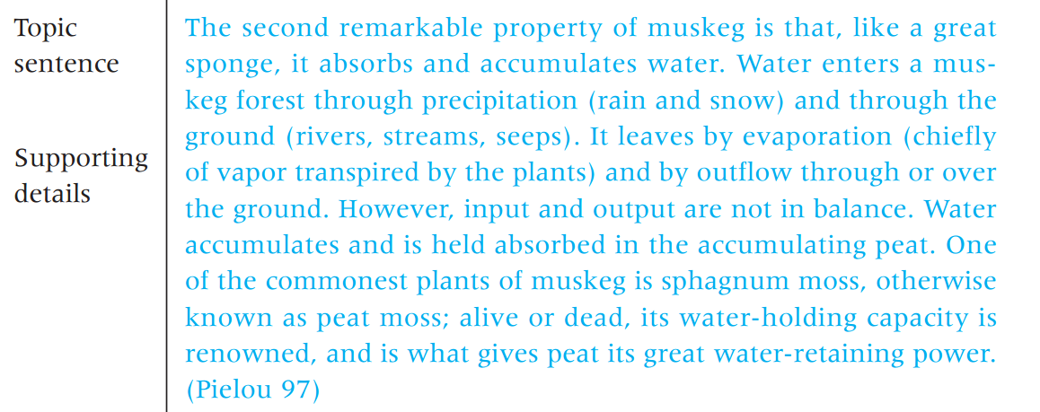
4. Put the Topic Sentence First

Slide 25
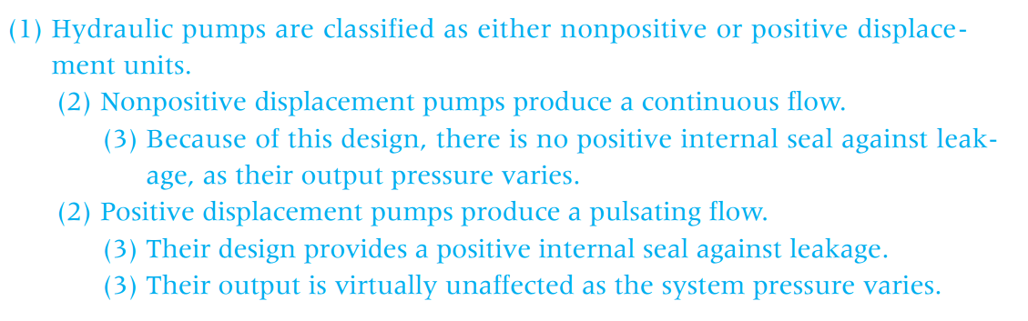
5. Arrange Sentences by Level
Hydraulic pumps are classified as either nonpositive or positive displacement units. Nonpositive displacement pumps produce a continuous flow. Because of this design, there is no positive internal seal against leakage, and their output varies as pressure varies. Positive displacement pumps produce a pulsating flow. Their design provides a positive internal seal against leakage. Their output is virtually unaffected as system pressure varies.

Slide 26
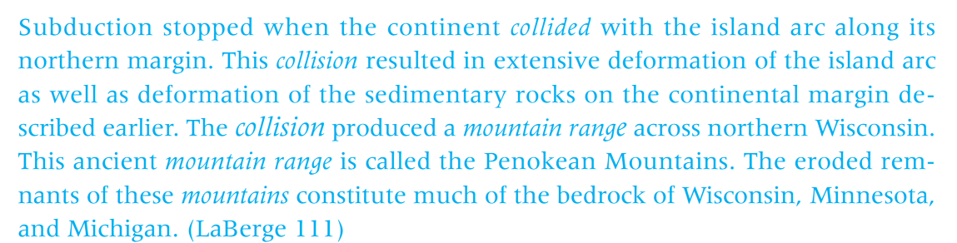
6. Repeat Terms in a New/Old Sequence

Slide 27
7. Provide Transitions
first/second
not only/but also
however, therefore
and but are

Slide 28
Choose a Tone for the Reader

Slide 29
Learn to control tone
Forceful
Passive
Personal
Impersonal

Slide 30
1. Forceful
Use the active voice.
Use the subject–verb–object structure.
Do not use “weasel words” (possibly, maybe, perhaps).
Use imperatives
Clearly indicate that you are the responsible agent

Slide 31
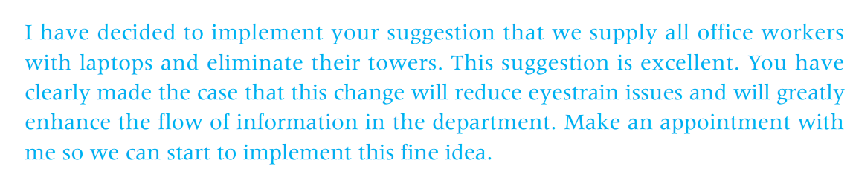

Slide 32
2. Passive
Avoid imperatives.
Use the passive voice.
Use “weasel words” (very, several people, quite, fairly).
Use longer sentences.
Do not explicitly take responsibility

Slide 33
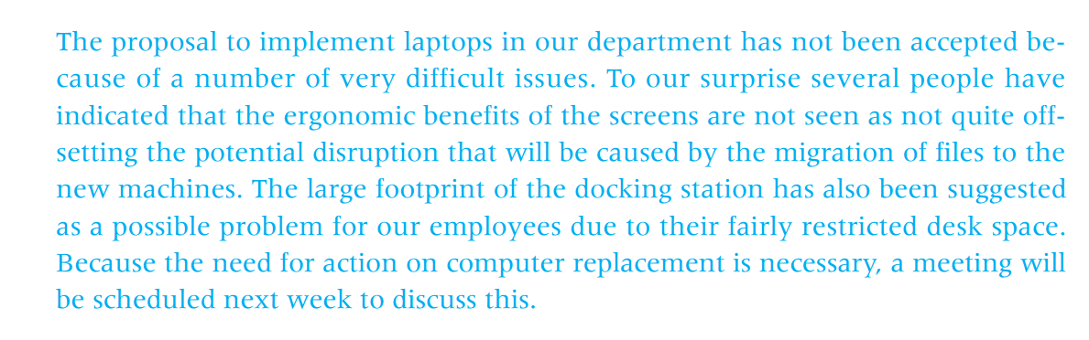
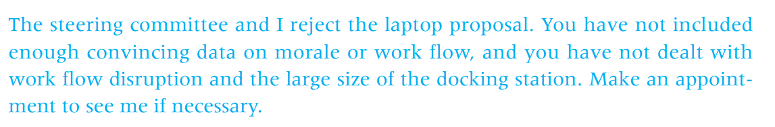

Slide 34
3. Personal
Use the active voice.
Use first names.
Use personal pronouns.
Use short sentences.
Use contractions.
Direct questions at the reader.

Slide 35
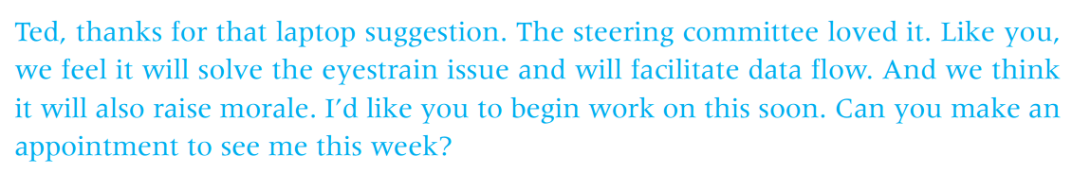
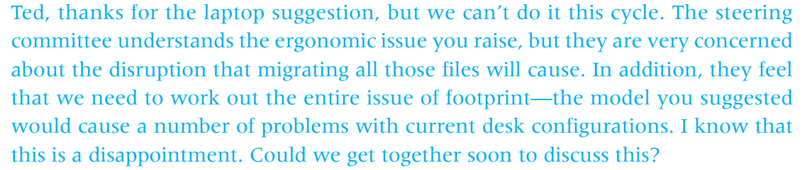
This tone is also appropriate for delivering a negative message when both parties are equal.

Slide 36
4. Impersonal
Do not use names, especially first names.
Do not use personal pronouns.
Use the passive voice.
Use longer sentences.

Slide 37
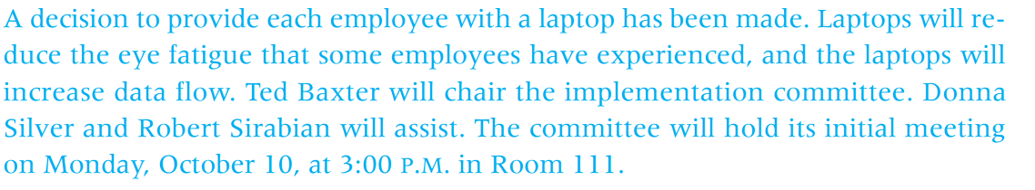

Slide 38
Source
Riordan, D. (2014). Technical report writing today. Cengage Learning.

